Slide 1



What do you do when you know that you don’t know?
Abhijit Bendale*, Terrance Boult
Samsung Research America*
University of Colorado of Colorado Springs
Notes:
Hi. I am Abhijit Bendale and I will present work on “What do you do when you know that you don’t know?”. This is joint work with Prof. Terrance Boult at University of Colorado.

Slide 2
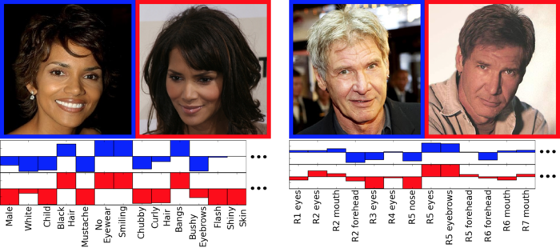
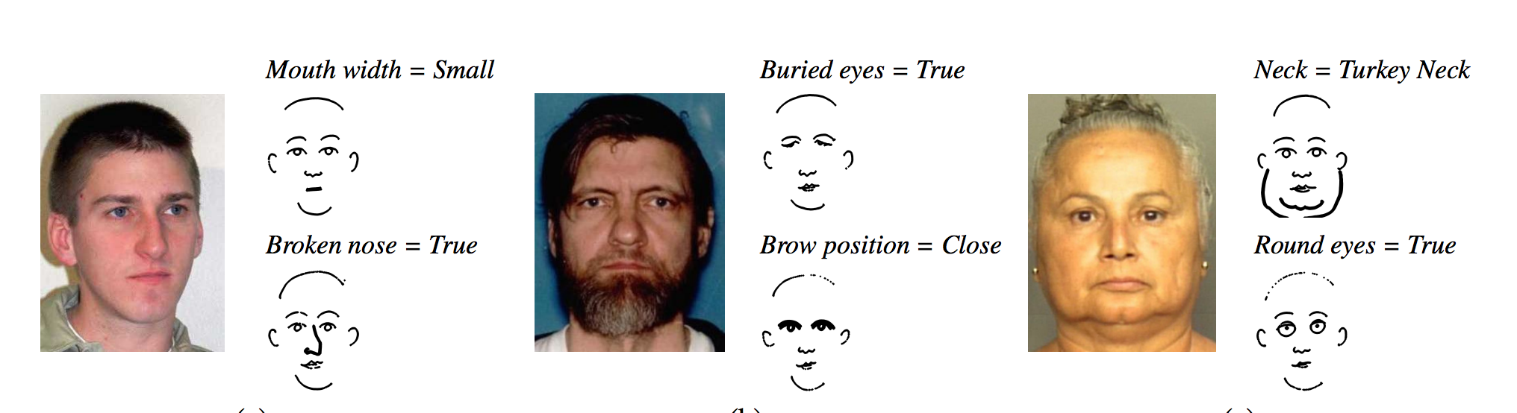
Facial Attributes
N Kumar, A Berg, P Belhumeur, S Nayar “Describable Visual Attributes for Face Verification and Image Search” IEEE TPAMI 2011
B Klare, S Klum, J Klontz, E Taborsky, T Akgul, A Jain “Suspect Identification Based on Descriptive Facial Attributes” IEEE/IAPR IJCB 2014
Notes:
Describable visual attributes are a powerful way to label different aspects face images, which when taken together build a detailed representation of a person’s appearance. Attributes correspond to semantically meaningful labels for characteristic face properties such as skin color, age, gender, hair color, expression etc. Facial Attributes based representations enable highly accurate approaches to a variety of tasks such as face verification, image retrieval and face recognition. As a result, interest in facial attributes based face recognition has grown substantially in recent years in Biometrics community, thanks to their ease of implementation, scalability and flexibility of representation.

Slide 3
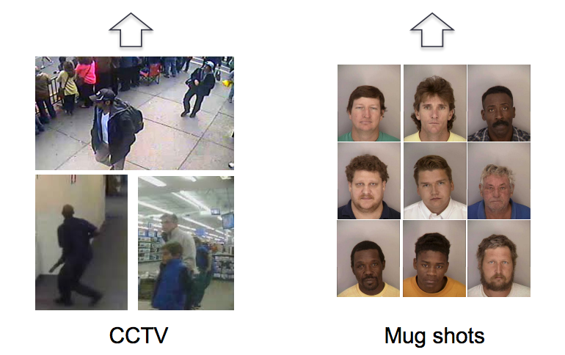
Facial Attributes Based Face Recognition
Probe
Face Recognition System
Gallery
CCTV
Mugshots
B Klare, S Klum, J Klontz, E Taborsky, T Akgul, A Jain “Suspect Identification Based on Descriptive Facial Attributes” IEEE/IAPR IJCB 2014
Notes:
In a typical face recognition system, based on facial attributes features, pre-trained classifiers are used to extract facial attributes from probe image. These attributes, along with additional data for e.g. sketch are provided to the system. The system performs matching across gallery of images based on these facial attributes and retrieves images of most similar looking faces. The matching is often performed by learning a classifier on top of facial attributes representation.

Slide 4
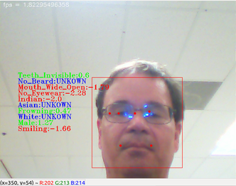
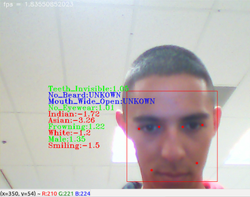
Unknowns in Real World
N Kumar, A Berg, P Belhumeur, S Nayar “Describable Visual Attributes for Face Verification and Image Search” IEEE TPAMI 2011
M Wilber, E Rudd, B Heflin, Y Lui, T Boult “Exemplar codes for facial attributes and tattoo recognition” WACV 2014
Notes:
However, extractions of facial attributes from pre-trained classifiers is far from perfect. A system for describable visual attributes for faces based on the work of Wilber et al and extended for open-set recognition is shown above. In the image, green text is a positive attribute, red text is negative attributes and blue color signifies unknown/missing attribute. The left image shows how bad lighting/feature- detection led to “UNKNOWN” labels for Asian and White attributes. The example on the right shows occlusion leading to the no beard attribute being labeled “UNKNOWN”. Handling such unknowns at run-time, in a learning-based system, poses considerable operational challenges. This paper is about what the system should do when it knows that it does not know about some features.

Slide 5
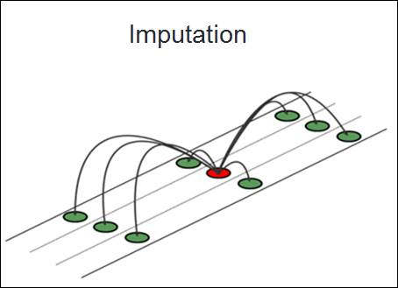
Handling Missing Features
Reduced Feature Models
Model 1
Model 2
Model 3
Model 4
Model 5
….
Y. Ding and A. Ross. “A comparison of imputation methods for handling missing scores in biometric fusion”. Pattern Recognition, pages 919–933, 2012
G. Chechik, G. Heitz, G. Elidan, P. Abbeel, and D. Koller. “Max-margin classification of data with absent features”. J. of Machine Learning Research, pages 1–21, 2008.
Notes:
There has been significant body of work in handling missing features for classification. These methods can be broadly classified into two categories: imputation based methods and stored models based methods. Imputation based methods involve substituting missing features with some pre-determined value like zero imputation, mean imputation or some other sophisticated method. For methods based on reduced feature models, models are constructed for each type of missing pattern separately making the problem computationally extremely expensive. Such methods are unsuitable for biometrics where feature dimensionality tends to be very high.

Slide 6

Our Operational Scenario
Access to only stored model and operational data
No prior knowledge of nature of missing data
Storage limitation : Cannot store countless “reduced models”
Impractical for face recognition
Operational Data /
Support Vectors
Stored Model
Decision Score
Test Data
P(A) or P(B)
Missing Data
At Test Time
Notes:
This leads to a unique operational scenario for biometrics for run-time adaptation. At run time, only stored model and operational data is available for adaptation. The nature of missing data is not known apriori. There are significant storage challenges. Hence, we ask the question: How to adapt pre-trained models at runtime for handling missing features?

Slide 7
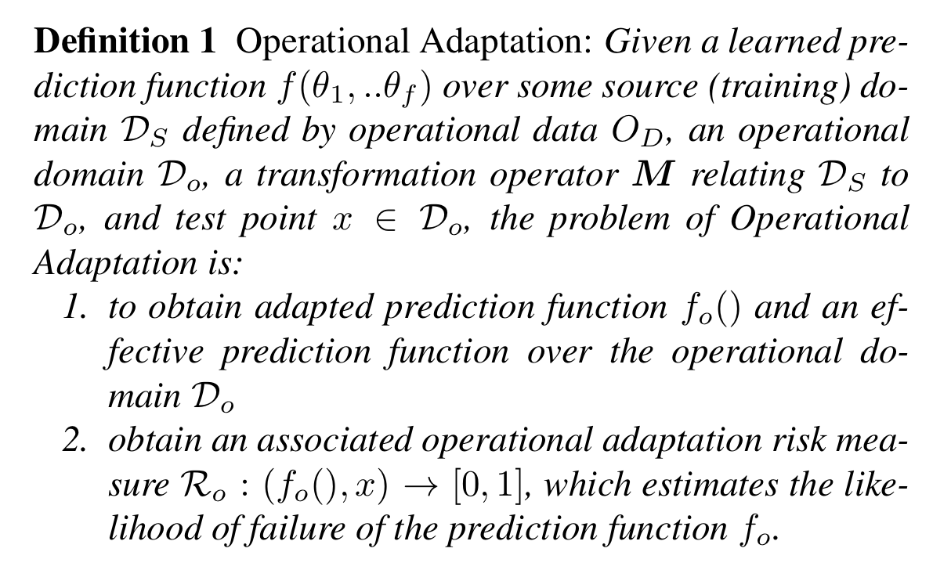
Operational Adaptation
Notes:
We first define the problem of operational adaptation. Given a learned prediction function over some source domain and operational data, the problem of operational adaptation is to obtain adapted prediction function over operational domain and obtain associated operational adaptation risk measure, which estimates the likelihood of failure of the prediction function.

Slide 8



Support Vector Machines
subject to
Differentiate wrt w and b to get solution
Notes:
Support vector machines create a discriminative classifier by constructing a hyperplane in high dimensional space. The problem is formulated as a optimization problem over training data. The solution of this optimization problem is obtained by solving for weight vectors which defines the hyperplane’s orientation and bias term that defines position of the plane with respect to origin.

Slide 9
SVM Bias Projection
Notes:
The bias is optimal stopping criterion of SVM problem when ALL feature dimensions are present. When features are missing, there is no way to re-generate optimality conditions (apart from re-training in reduced feature space). This is not possible at operational time, since all data might not be present for training.
In order to optimize SVM for handling missing features, we propose refactoring of bias term in the projected space. With Bias re-factoring, the data and bias both are projected in the lower dimensional subspace. Above figure shows an illustration of the procedure in 3D. For zero imputation, if Z is missing, since the distances are computed in X-Y plane the bias continues to remain in higher dimension, leading to much higher bias term as shown by dashed red line. If the feature on Z axis is missing, Pz projects the data and the bias vector in X-Y plane, effectively using Red margin. The approach of this paper, run time bias estimation (RTBE), adjusts the bias from the margin to the original plane to appropriate the projection subspace

Slide 10
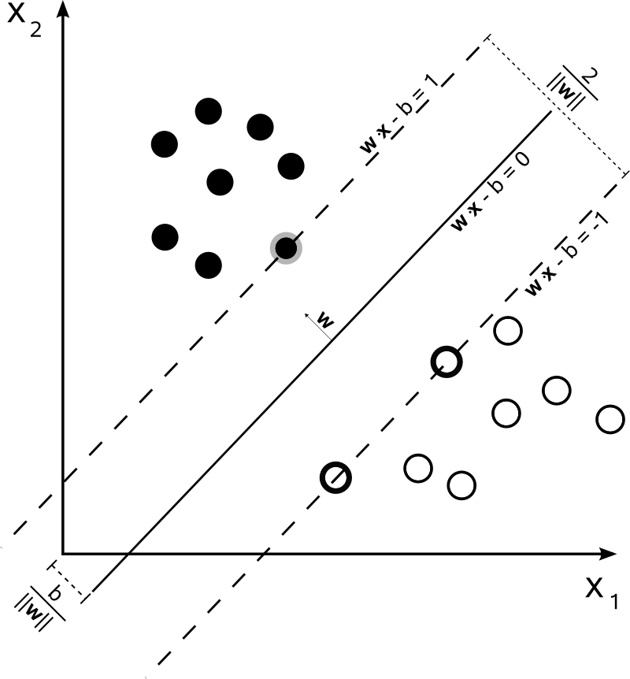
Missing Data in Context of Linear SVMs and Imputation
X₁ = 0
Misclassification
caused due to zero
imputation
X₂ = 0
Notes:
On a very intuitive note, we can consider this quick example on 2D. Due to missing features in 2D, the problem gets reduced to projection on the other axes thereby a 1D classification problem. However, samples get miss-classified in the projected dimensions

Slide 11
Run Time Bias Estimation
New hyper plane obtained
After optimizing the bias term
Project Operational Data
Optimize for Bias
Obtain optimal hyper plane in operational domain
Classify in the projected domain
Notes:
The proposed run-time bias estimation approach performs grid search for varying values of bias to find a new SVM solution in the projected dimension

Slide 12
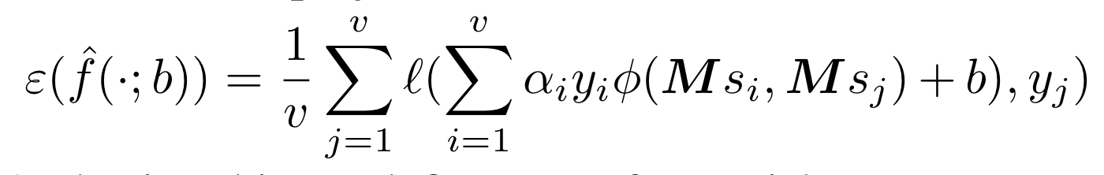
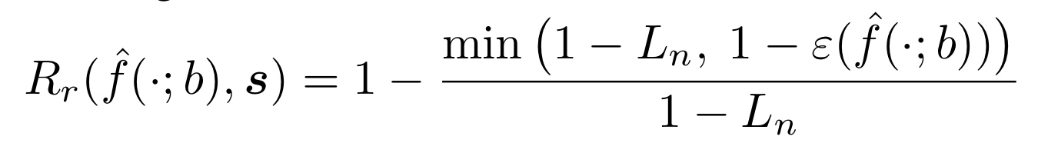
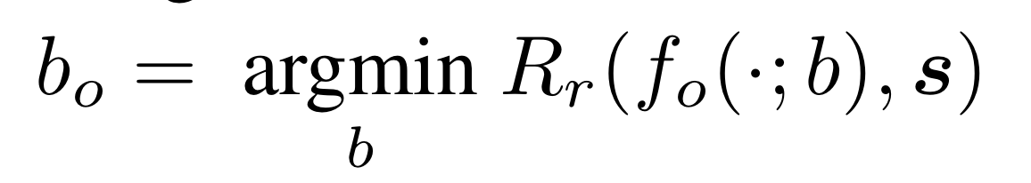
Run Time Bias Estimation
Refactored Projection Error
Refactor Risk
Optimal Bias : Minimize Refactor Risk
Notes:
How does this optimization work? The process of optimization is a three step process. We define refactored projection error as error accumulated over empirical loss function associated with a particular set of projections. Following this we define and compute refactor risk as the relative risk compared to the original loss. We include the min() because noise or irrelevant variables may result in the projected support vectors having lower empirical risk than that in the original space. Finally, computation of optimal bias is constructed as a 1D grid search over refactor risk and the support vectors projected in the subspace of missing features.

Slide 13
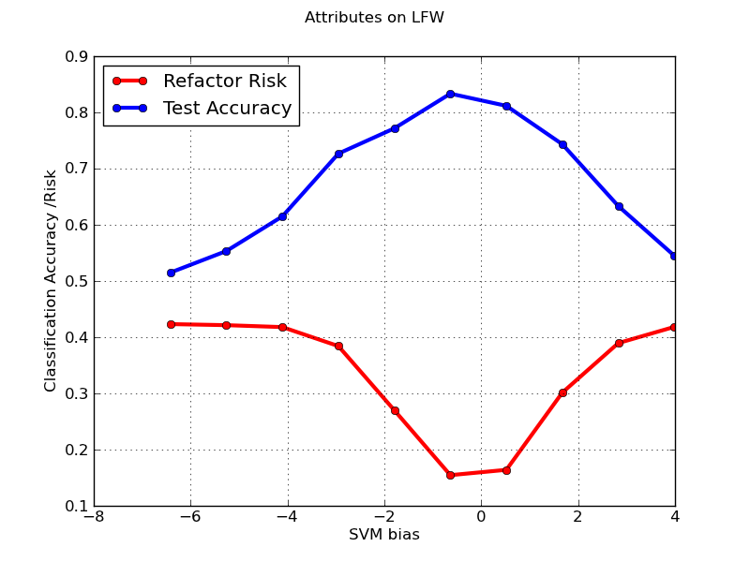
Bias vs Refactor Risk
Notes:
Effect of Varying SVM Bias on classification accuracy on test set and associated refactor risk. It can be observed that when our refactor risk is minimum, maximum classification accuracy over test is obtained (Test Accuracy was scaled between 0 - 1 to fit this plot). Our objective is to obtain value of SVM bias b for which refactor risk is minimum. In the above experiment, 30% features were removed for each dataset during testing phase. This is shown to illustrate correlation between refactor risk and test accuracy, however, during optimization for refactor risk and bias, we do not have access to test data.

Slide 14



Experimental Setup
USPS Dataset
0-9 Numbers, 9298 images,
7291 for training, 2007 for testing
Each image represented as 256 dimensional vector
Binary Classification : 1-vs-All
MNIST Dataset
0-9 Numbers, 70000 images,
60000 for training, 10000 for testing
Image size 28x28. Feature size 784
Binary Classification : 1-vs-All
LFW Dataset
Pair Matching
6000 images. 5400 Training, 600 Testing 10 fold validation
Feature type: Attributes of faces. Feature vector size: 146
Binary Classification : Same pair, different Pair
Notes:
We consider three datasets for our evaluation. USPS and MNIST are handwriting recognition datasets and Labeled Faces in the Wild Dataset is face verification dataset. USPS dataset has about 9200 images with 256 dimensional features, MNIST dataset has 70000 images with 784 dimensional features. LFW dataset contains 6000 images of which 5400 are used for training and 600 for testing followed by 10 fold cross validation. Overall 146 facial attributes were extracted for faces and was used to perform pair matching for face verification

Slide 15
Notes:
A question might arise that why not train with support vectors instead of trying to refactor bias? We performed this experiment and presents results here for a small experiment. 30% features for USPS dataset were removed at random. Performance when all features are present, zero imputation, the proposed method of run time bias estimation and training with only support vectors are shown. It can be seen that gains for the proposed method are consistently better across different digits on USPS dataset.

Slide 16
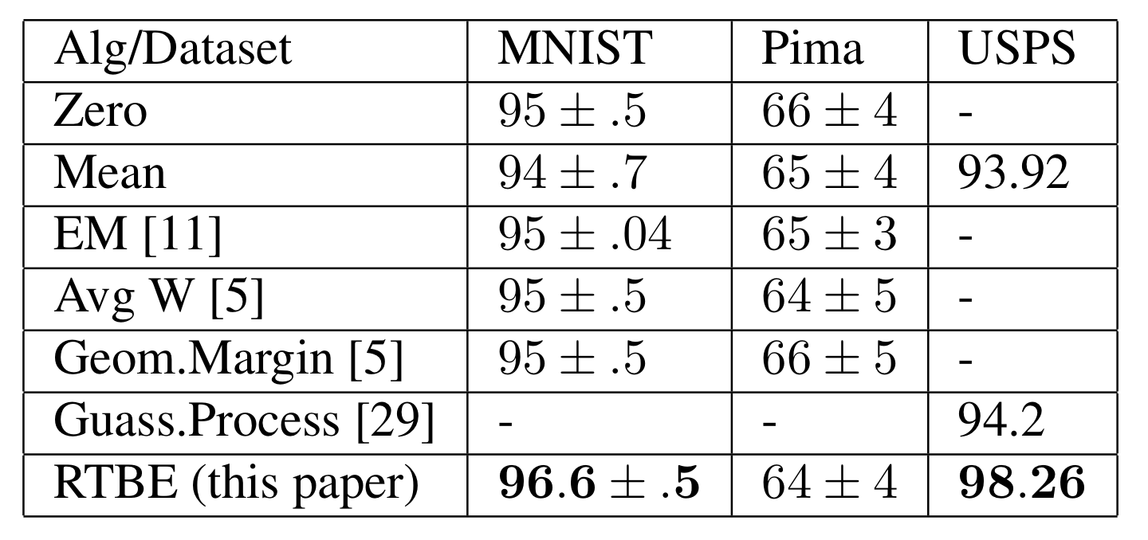
Comparison with Other Methods
[5] G. Chechik, G. Heitz, G. Elidan, P. Abbeel, and D. Koller. “Max-margin classification of data with absent features”. J. of Machine Learning Research, pages 1–21, 2008.
[11] Z. Ghahramani and M. I. Jordan. “Supervised learning from incomplete data via an EM approach” NIPS 1994
[29] A. J. Smola, S. V. N. Vishwanathan, and T. Hofmann. Kernel methods for missing variables. In Proc. Wksp on Articial Intelligence and Statistics, 2005
Notes:
We now present comparison with other methods, with best algorithm in bold if it is more than a standard deviation above. For MNIST and PIMA datasets when features are randomly dropped, the best results were reported by Chechick etal in their geometric margin method. For USPS dataset, when 25% of data was missing, Gaussian processes based methods were the state of the art. We include PIMA as an example dataset, since all algorithms were tested on this dataset. RTBE estimation is comparable with other methods on PIMA dataset and on larger datasets such as MNIST and USPS handwriting recognition dataset, the proposed method outperforms existing methods.

Slide 17
USPS Dataset for Handwriting Recognition
Notes:
The above figure shows results obtained when features are systematically removed from feature vectors at random for USPS handwriting recognition dataset. The blue triangle represents baseline classification results when all features were present. Green curve with square markers represents results obtained using zero imputation. Red curve with circle markers represents the proposed approach of run time bias estimation. On the left hand side results with linear SVM are plotted and on the right side results with RBF SVM are plotted. All other SVM hyperparameters remained same for both the experiments. We see that as features are being removed, performance for both the methods drop which is expected. However, performance degradation for Run time bias estimation is much more graceful compared to zero imputation. The difference is more pronounced for RBF kernel.

Slide 18
MNIST Dataset for Handwriting Recognition
Notes:
This is a similar plot for performance on MNIST dataset. The performance gain of run time bias estimation continues to be significant for both linear and RBF kernels.

Slide 19
Facial Attributes on LFW dataset for Face Verification
Notes:
The above figure shows performance on face verification task on Labeled Faces in the Wild Dataset. Facial attributes were extracted using method proposed by Kumar et al. For both linear and RBF kernels, performance improvements are significant when 40 to 50% features are missing.

Slide 20
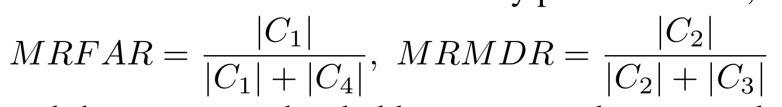
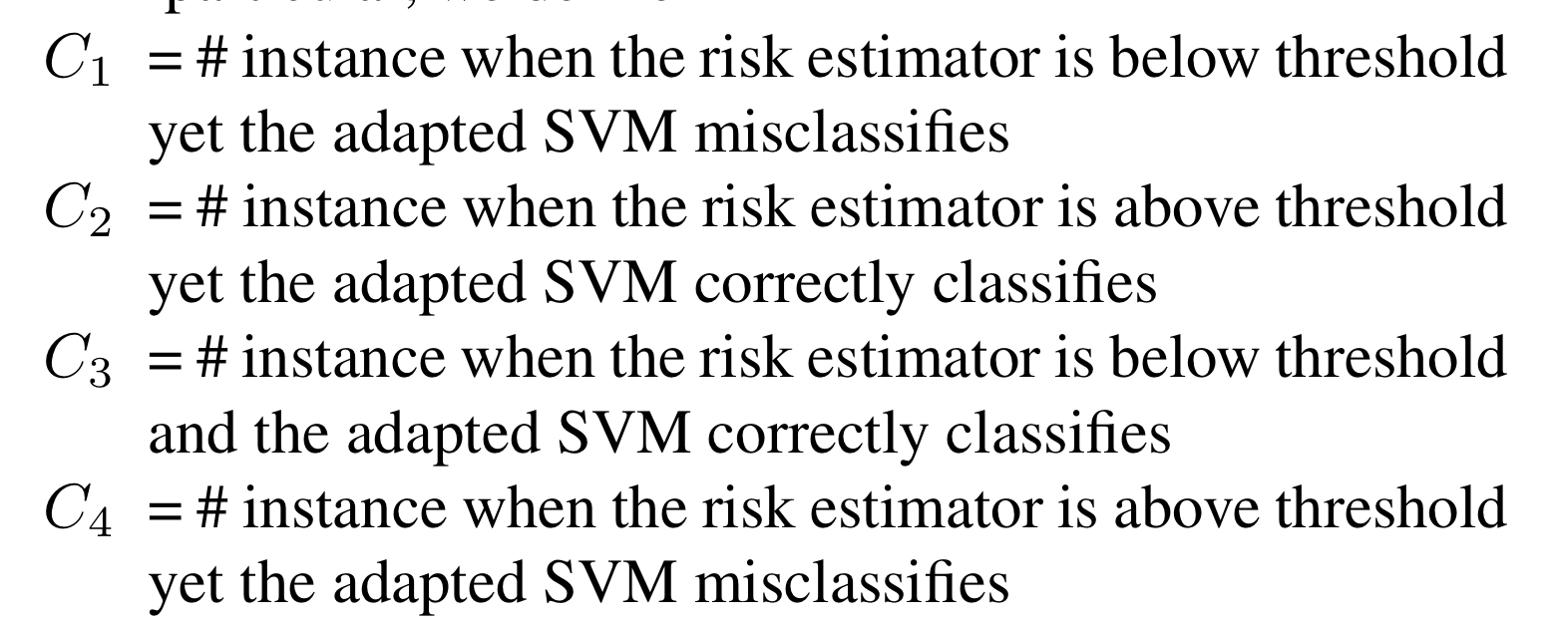
Risk Estimation for Missing Data
Meta-Recognition False Accept Rate
Meta-Recognition Miss Detection Rate
Notes:
To evaluate the effectiveness of the Adaptation Risk Estimation, we use the meta-recognition evaluation paradigm with Meta-Recognition Error Trade-off Curves (MRET). The curve considers how often the risk estimator correctly predicts the failure/success of the underlying classifier. We consider two risk estimation approaches: percentage of missing features (wrt to total features) and the proposed adaptation risk estimator. For risk estimation with percentage of missing features, we drop features in steps (e.g. 10%, 20% etc.) and at each step we predict success/failure.

Slide 21
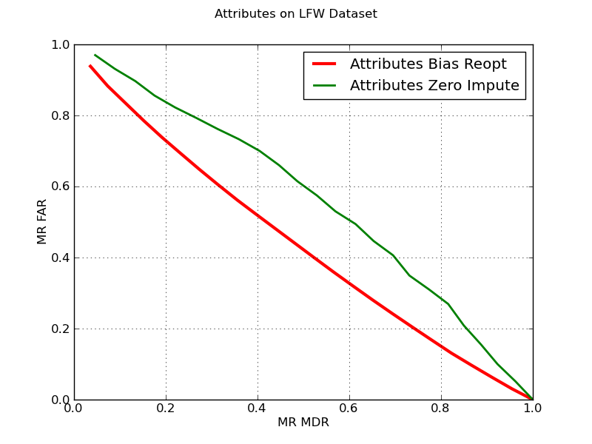
Meta-Recognition Analysis for
Missing Data
Ideal Risk Estimator
Notes:
Meta-recognition False accept rate is the fraction of time the risk was low but the SVM classification failed, and the Meta-recognition miss detection rate is the fraction of time the risk was high yet the SVM corrected classified the partial data. The ideal location is the lower-left. The plot shows the adaptation risk estimator for SVM refactoring (RTBE) is better than risk estimation for zero- imputation. The above figure shows MRET curves for the proposed run time bias estimation method and zero imputation. It can be seen that Run time bias estimation based risk estimation is more reliable compared to using percent missing features and zero imputation.

Slide 22
Conclusion
Operational Adaptation for Biometrics Systems
Algorithm for Run Time Bias Estimation for SVMs as an effective way for handling missing features
Adaptation Risk Estimator for SVMs
Meta-Recognition Analysis for handling missing features
Notes:
In conclusion, we presented the problem of operational adaptation for biometrics system. We presented an algorithm for Run Time Bias Estimation for SVMs as an effective way for handling missing features. The proposed method provides performance improvements over existing state of the art methods, without any additional overhead of storage or compute time. Further, we developed the concept of adaptation risk estimation for Support Vector Machines and demonstrated usefulness of Meta Recognition Analysis for handling missing features at test time.

Slide 23
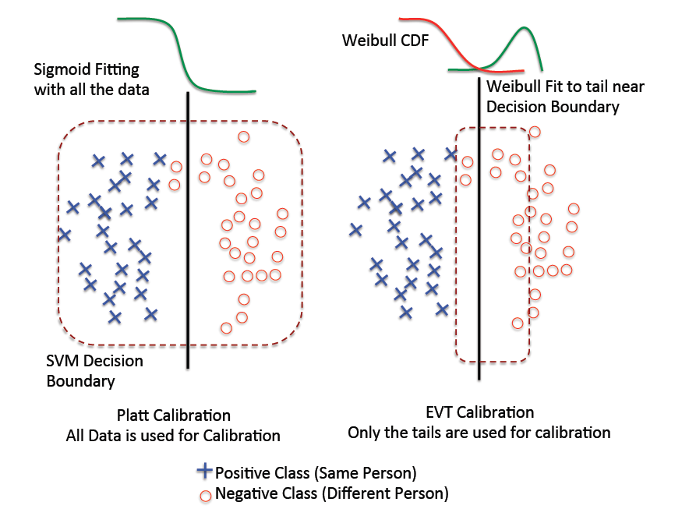
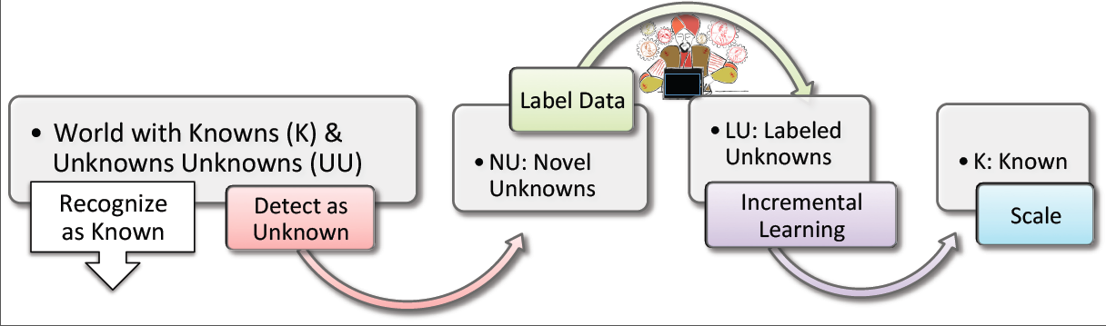
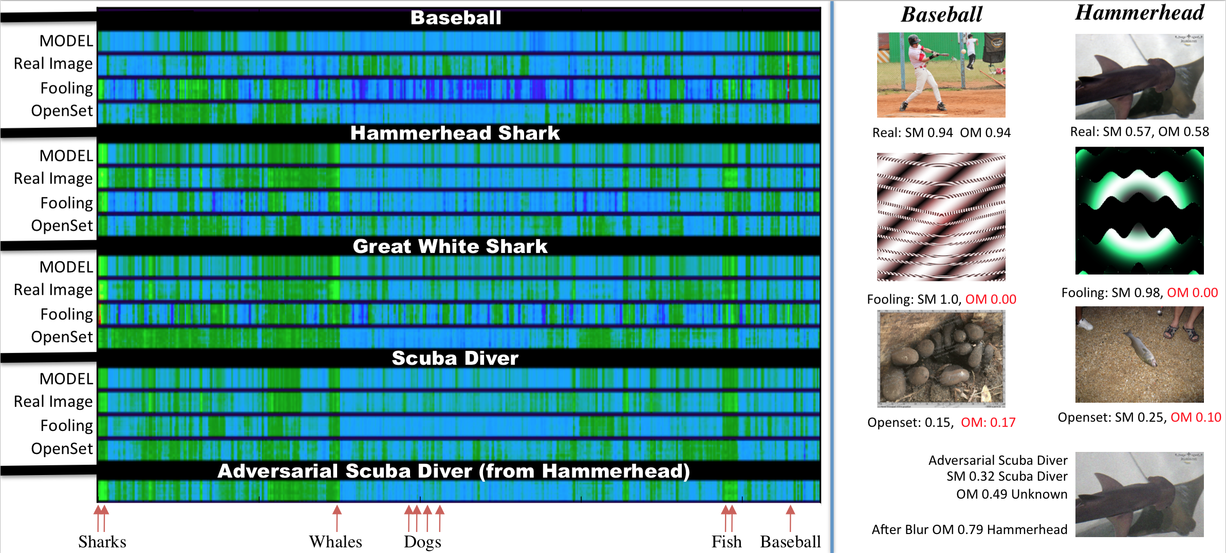
Future Work
A Bendale, T Boult “Reliable Posterior Probability Estimation for Streaming Face Recognition” CVPR Biometrics Workshop 2014
A Bendale, T Boult “Towards Open World Recognition” CVPR 2015
A Bendale, T Boult “Towards Open Set Deep Networks” CVPR 2016
Tuesday – June 28
10:00 – 10:30 AM Short Oral
10:30 AM – 12:30 PM Poster Session
Notes:
Handling and modeling classifier uncertainty in open world still remains a huge challenge. Real world is open, uncertain and with unique operational challenge.
We tried to address some of these challenges in our previous work. However, this work is prequel to all the above papers. We did this work in 2012, but this paper kept of getting rejected. Thanks for your attention and I can now take questions.

Slide 24
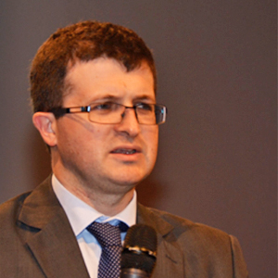


We are releasing code for this work along with libsvm wrappers…!
I don’t trust you or your claims
☺ Awesome..!!
Notes:
Dr. Sebastien Marcel, who is session chair for this

